Slide 1
Human Activity Recognition
By: Raghwendra Mahato

Slide 2
Introduction
The ability to decode the human activities by the use of technology is called Human Activity Recognition, or HAR.
With Recent advancement in technology, it is now possible to recognise the standard activities performed by the smart device user with the help of state-of-the-art technology.
Data is generated by several ways like videos, still images, or sensors in the smart devices such as phones or watches.
Deep Learning models can be employed in such a recognition systems.
Wide range of applications like human-computer interaction, user interface design, robot learning, and surveillance.

Slide 3
Project Highlights
Dataset provided by Datamites.
Data consists of activity column 0 and 1.
Descriptive analysis is performed and insights were drawn.
Predictive analysis is performed using LSTM model.
This model is used to predict the state of the body specifically running state or walking state based on the linear acceleration and angular velocity data of three axis.
Evaluating the model gives test accuracy of 0.9988706.

Slide 4
Dataset Info
Shape: (88588,11)
Activity : 0 for Running and 1 for Walking.
Wrist: 0 for Left Wrist and 1 for Right Wrist.
Balanced Dataset: Activity 0 = 44365 and Activity 1 = 44223.
X, Y and Z coordinates data from Accelerometer sensor and Gyro sensor.
No missing Data.

Slide 5
Deep Learning Model Used
LSTM with 100 neurons
Bidirectional
Dropout of 50% to avoid overfitting issue
Optimiser: adam
Loss function: mse

Slide 6
Metrices evaluation
Training Accuracy
Training Loss
Validation Accuracy
Validation Loss
Test Accuracy
Test Loss
Confusion Matrix

Slide 7
Libraries Used
Pandas
Numpy
Matplotlib
Seaborn
Scipy
Sklearn
Time, datetime
Keras

Slide 8
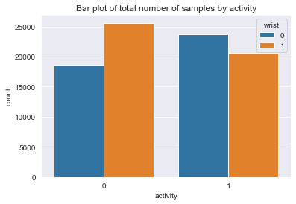
Data Visualization and Descriptive Analysis

Slide 9
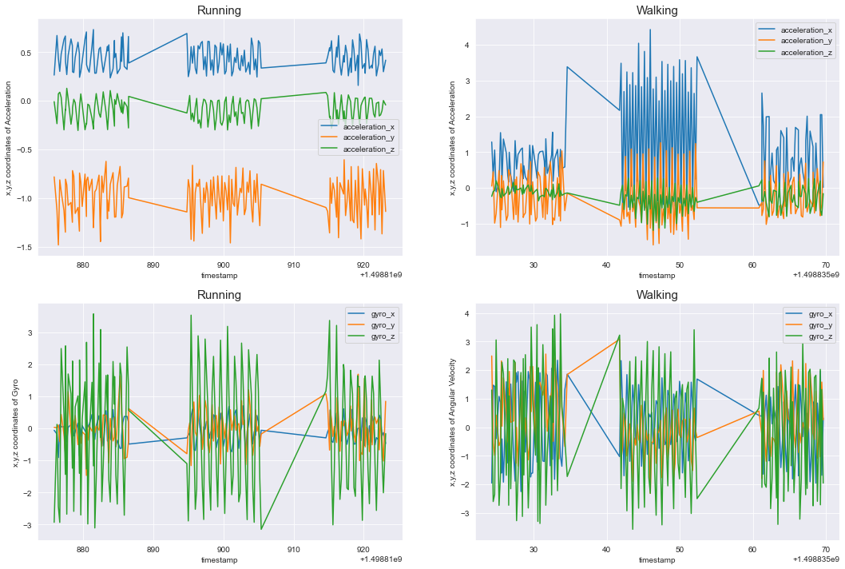

Slide 10
Data Visualization and Descriptive Analysis(contd….)
X, Y, Z coordinates of Acceleration and angular velocity is plotted verses the timestamp. We can see that timestamp is not continuous, it because all the samples are not collected at once at one-go. Running and Walking activity is performed on different dates at different times. However, all the data is from same user.
Analysing Running data, shows that, x-coordinates of acceleration is always greater than z-coordinates than y-coordinates. while, this is not true for walking. For Walking, The mean value of x-coordinates is greater than y and z coordinates. Although, the mean value of y and z coordinates of acceleration is almost same, the variance of y-coordinates of acceleration is far greater than z-coordinates. The z-coordinates of acceleration while walking barely changes. X-coordinates varies more than y-coordinates.
While analysing angular velocity data, we can observe that, the variance of z-coordinates is greater than x and y coordinates while performing both activities. It can also be observed that, variance of x and y coordinates of angular velocity while Running has less variance than when walking.

Slide 11
Data Processing
Subsampling the samples with time_steps of 50 timesteps.
Reshaping the data in a form suitable for feeding into LSTM model.
One hot encoding.
Train test split with test_size of 0.2.

Slide 12
Predictive Analysis Building LSTM Architecture
model = Sequential()
model.add(Bidirectional(LSTM(100, activation='relu'), input_shape = (X_train.shape[1], X_train.shape[2])))
model.add(Dropout(0.5))
model.add(Dense(units = 50, activation='relu'))
model.add(Dense(y_train.shape[1], activation = 'softmax'))
model.compile(loss='mse', optimizer='adam', metrics=['accuracy'])

Slide 13
Training the model
Epochs = 50
Vlidation_split = 0.2
Batch size = 1014
model.fit(X_train, y_train, epochs = 50, validation_split = 0.20, batch_size = 1014, verbose = 1)

Slide 14
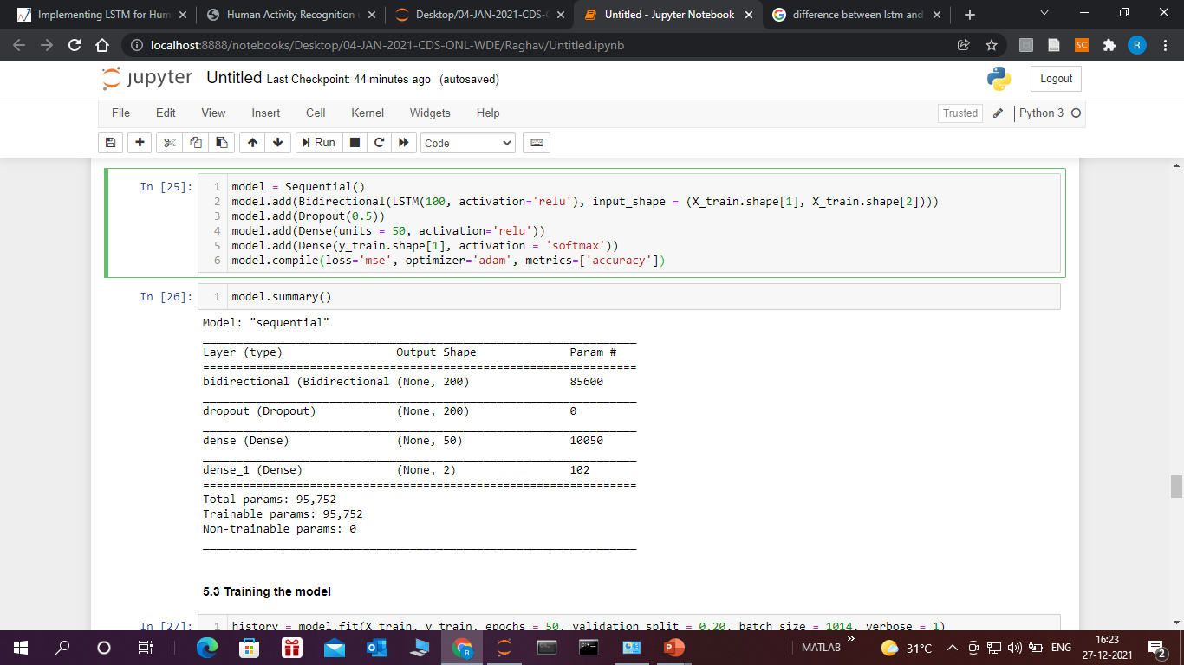
model.summary()

Slide 15
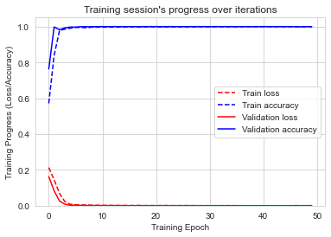
Evaluation Train and Validation Accuracy and Loss

Slide 16
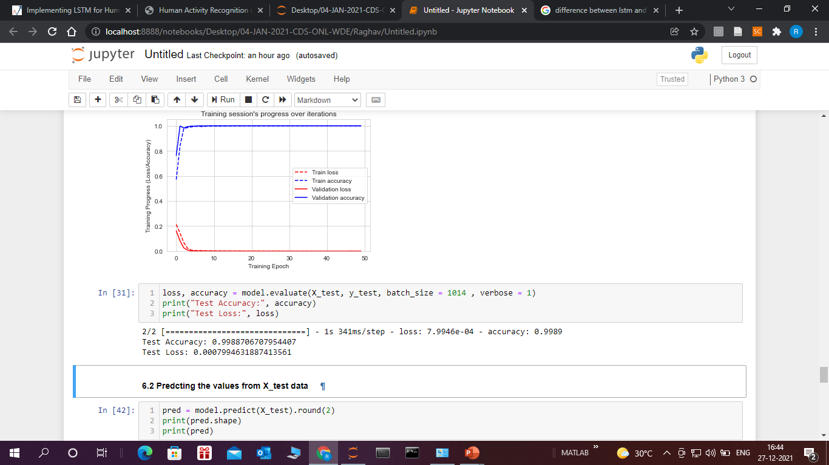
Test Accuracy and Test Loss

Slide 17
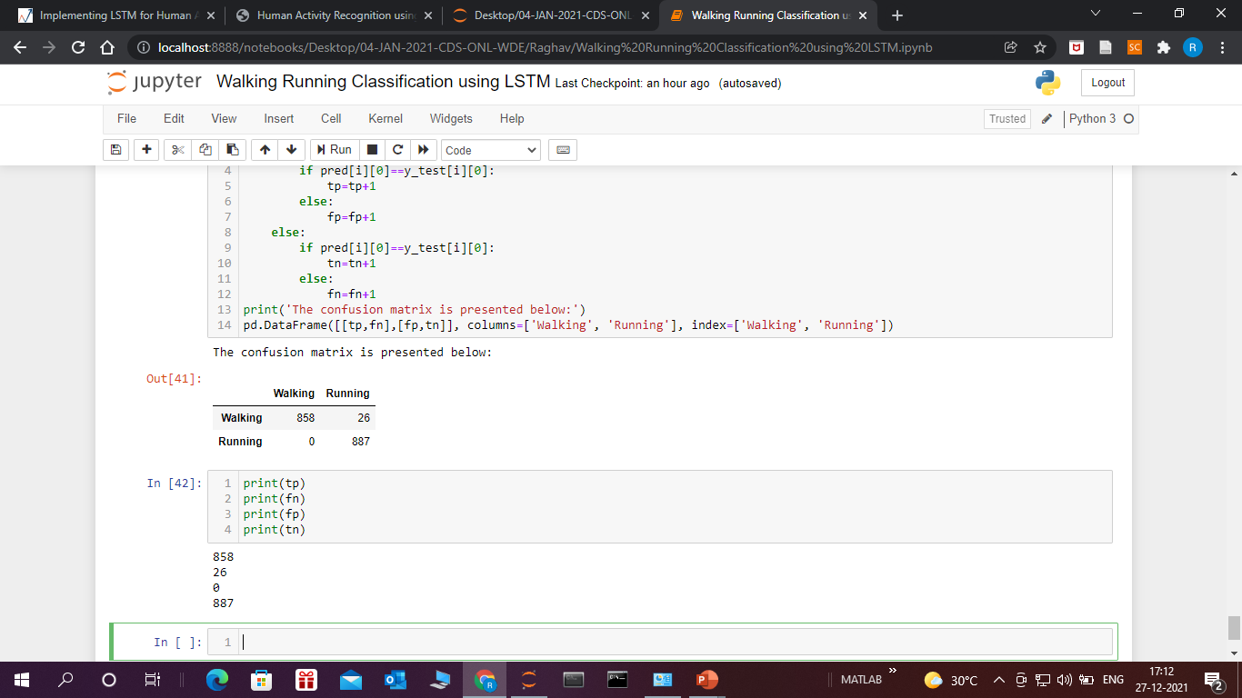
Confusion Matrix

Slide 18
Conclusion
The model is successfully predicting the state of body i.e. Running or Walking with the test accuracy of .9988706.
The problem of over fitting is also taken care of by employing Dropout function in the LSTM model.
The reliability of the model can also be verified by confusion matrix with gives only 26 mismatch out of 8854 subsamples.
This score is achieved by training model with only 50 epochs.
We tried to train for 50 more epochs and evaluate the performance of the model.

Slide 19
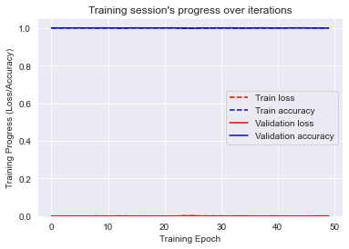
Training for another 50 epochs Train and Validation Accuracy and Loss
Test Accuracy: 0.9983060359954834
Test Loss: 001648790086619556

Slide 20

Conclusion
We found that Test Accuracy has not improved while training the model for another 50 epochs. However, it has slightly reduced. This is due to overfitting of the model with training data.
This can also be verified from confusion matrix achieved while training the model for another 50 epochs.
It is evident that , now we have 28 mismatch data , performance of the model is degraded after training it for another 50 epochs.

Slide 21
Thank you

